Slide 1
ShopX Cancellation Analysis
Root Causes & Recommendations
Data Analysis & Insights • March 2026

Slide 2
Expected Outcome
How to reduce overall cancellation rate from 14-17% to 10-12%, saving thousands of orders and improving customer satisfaction scores.

Slide 3
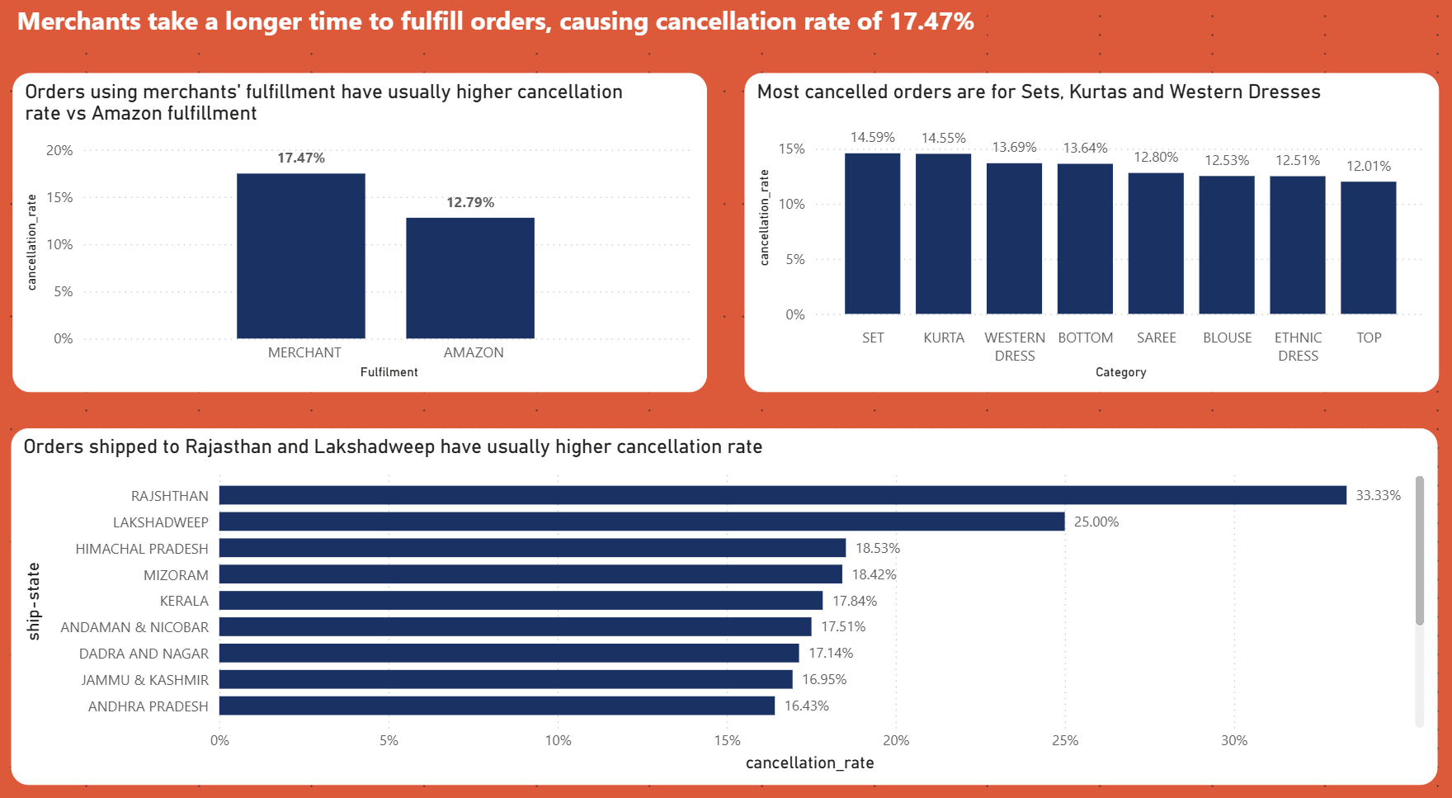
Executive Summary
Notes:
Overall cancellation rate: 17.47% for Merchant vs 12.79% for Amazon fulfillment
Product categories: Sets, Kurtas, and Western Dresses have highest cancellation rates (14-15%)
Geographic hotspots: Rajasthan (33.33%) and Lakshadweep (25.00%) have critical issues
Root cause of cancelled orders: Slow merchant fulfillment creates customer abandonment

Slide 4
Key Finding 1: Fulfillment Gap
Merchant Fulfillment is 36% More Likely to Be Cancelled
Merchant-fulfilled orders experience a 17.47% cancellation rate compared to Amazon's 12.79%. This 4.68 percentage point gap represents thousands of lost orders and dissatisfied customers.

Slide 5
Key Finding 2: Geographic Concentration
Rajasthan: 33.33% cancellation rate (highest in platform)
Lakshadweep: 25.00% cancellation rate
These regions likely suffer from poor last-mile logistics infrastructure or extended delivery times causing customer impatience, ultimately leading to order cancellation.

Slide 6
Key Finding 3: Product Category Risk
Sets: 14.59% cancellation rate
Kurtas: 14.55% cancellation rate
Western Dresses: 13.69% cancellation rate
Ethnic and apparel items have inherently higher friction due to sizing concerns and fabric expectations in online shopping.

Slide 7
Root Cause: Merchant Fulfillment Speed
Analysis reveals that slow processing and shipping times by third-party merchants are the primary driver of cancellations.
Customers in high-cancellation states expect 1-2 day delivery
Merchants takes more days to process orders, losing customer patience

Slide 8
Recommendation 1: Fulfillment Performance Gates
Implement Minimum Fulfillment Speed Requirements
Require merchants to ship within 24 hours or face promotional restrictions. Track "time to dispatch" as a KPI and penalize slow merchants by reducing their visibility in search rankings.

Slide 9
Recommendation 2: Migrate Top SKUs to FBA
Move High-Volume Products to Amazon Fulfillment
Identify the top 20% of Set, Kurta and Western Dress SKUs by sales volume and encourage or mandate those merchants to use Amazon FBA. This will instantly reduce cancellation rates in those categories.

Slide 10
Recommendation 3: Regional Logistics Partnerships
Target Rajasthan and Lakshadweep
Establish partnerships with regional courier services or open micro-fulfillment centers in these high-cancellation states to reduce delivery times and improve customer satisfaction.

Slide 11
Thank You
Questions?

